Slide 1
Smart Home Management
Presented By:
Abdul Rehman 19L-1135
Ammar Nadeem 19L-0911
Rohail Kamran 19L-0941

Slide 2
Problem & Solution

Slide 3
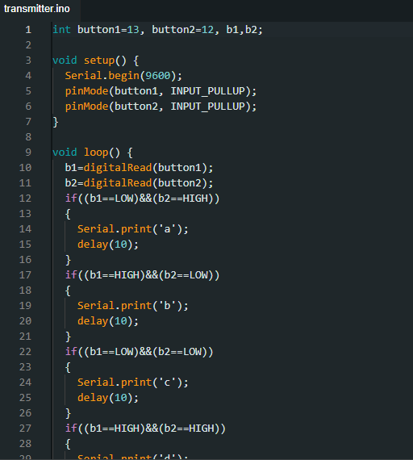
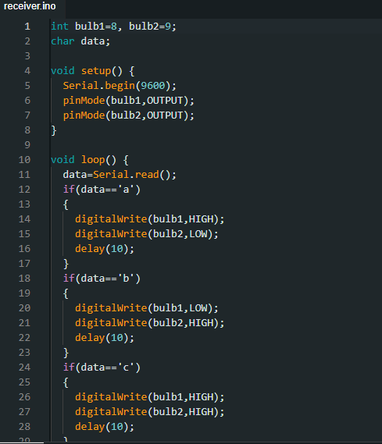
Proteus:

Slide 4
App & ThingsSpeak Demo

Slide 5


Slide 6
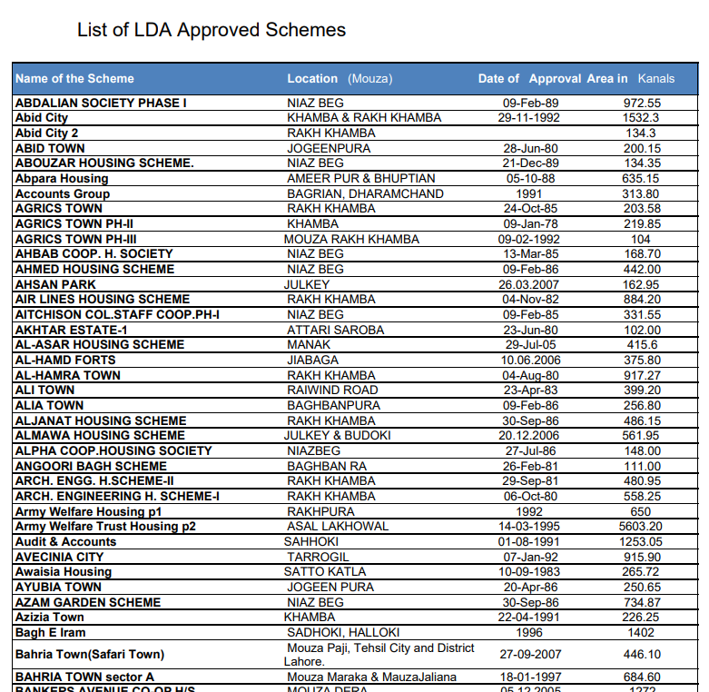
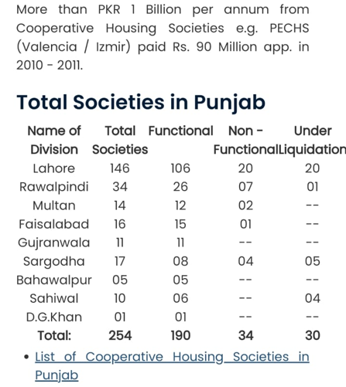
Estimated Target Market:

Slide 7
Estimated Revenue:
Init. Societies: 20 / 150 Est. Houses per Society: 600 / 1200
-------------------------------------------------------------
Middle Class: 11 (soc) * 600 (hos) * PKR 500/monthly
{ PKR 33,00,000 }
Up-Middle Class: 6 (soc) * 300 (hos) * PKR 2000/monthly
{ PKR 36,00,000 }
Upper Class: 3 (soc) * 300 (hos) * PKR 5000/monthly
{ PKR 45,00,000 }
--------------------------------------------------------------
Total: PKR 1,14,00,000/month

Slide 8
Estimated Installation Time:
Init. Target House: 9300 [(11*600)+(6*300)+(3*300)]
---------------------------------------------------------------
Middle Class: 11 (soc) * 600 (hos) * 15 - 30 mins/house
{ 138 Days } * 3 / 6 person
Up-Middle Class: 6 (soc) * 300 (hos) * 50 – 70 mins/house
{ 88 Days } * 3 / 6 person
Upper Class: 3 (soc) * 300 (hos) * 90 – 120 mins/house
{ 75 Days } * 3 / 6 person
----------------------------------------------------------------
Total: 69 Days + 21 Off-Days = 3 Months (18 (workers) * 3(months) * PKR 30,000 = PKR 17,00,000)

Slide 10
Question & Answer

Slide 11
Thank You

